Slide 1
South Carolina Retirement System Solvency Analysis
Prepared by: Pension Integrity Project at Reason Foundation. 2022—Preliminary Draft

Slide 2
About the Pension Integrity Project
We offer pro-bono technical assistance to public officials to help them design and implement pension reforms that improve plan solvency and promote retirement security, including:
Customized analysis of pension system design, trends
Independent actuarial modeling of reform scenarios
Consultation and modeling around custom policy designs
Latest pension reform research and case studies
Peer-to-peer mentoring from state and local officials who have successfully enacted pension reforms
Assistance with stakeholder outreach, engagement and relationship management
Design and execution of public education programs and media campaigns

Slide 3
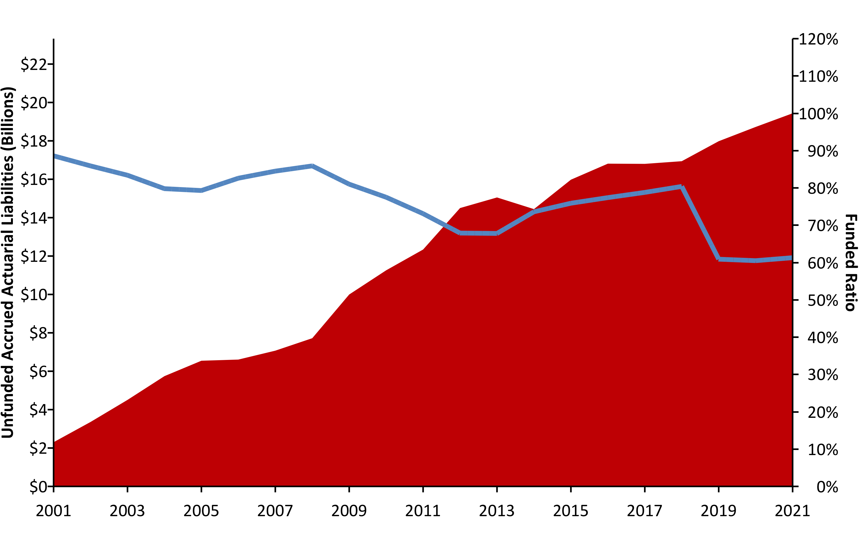
SCRS Unfunded Liabilities (2001-2021) w/ R (areaPlot())
Source: Pension Integrity Project analysis of SCRS actuarial valuation reports.

Slide 4
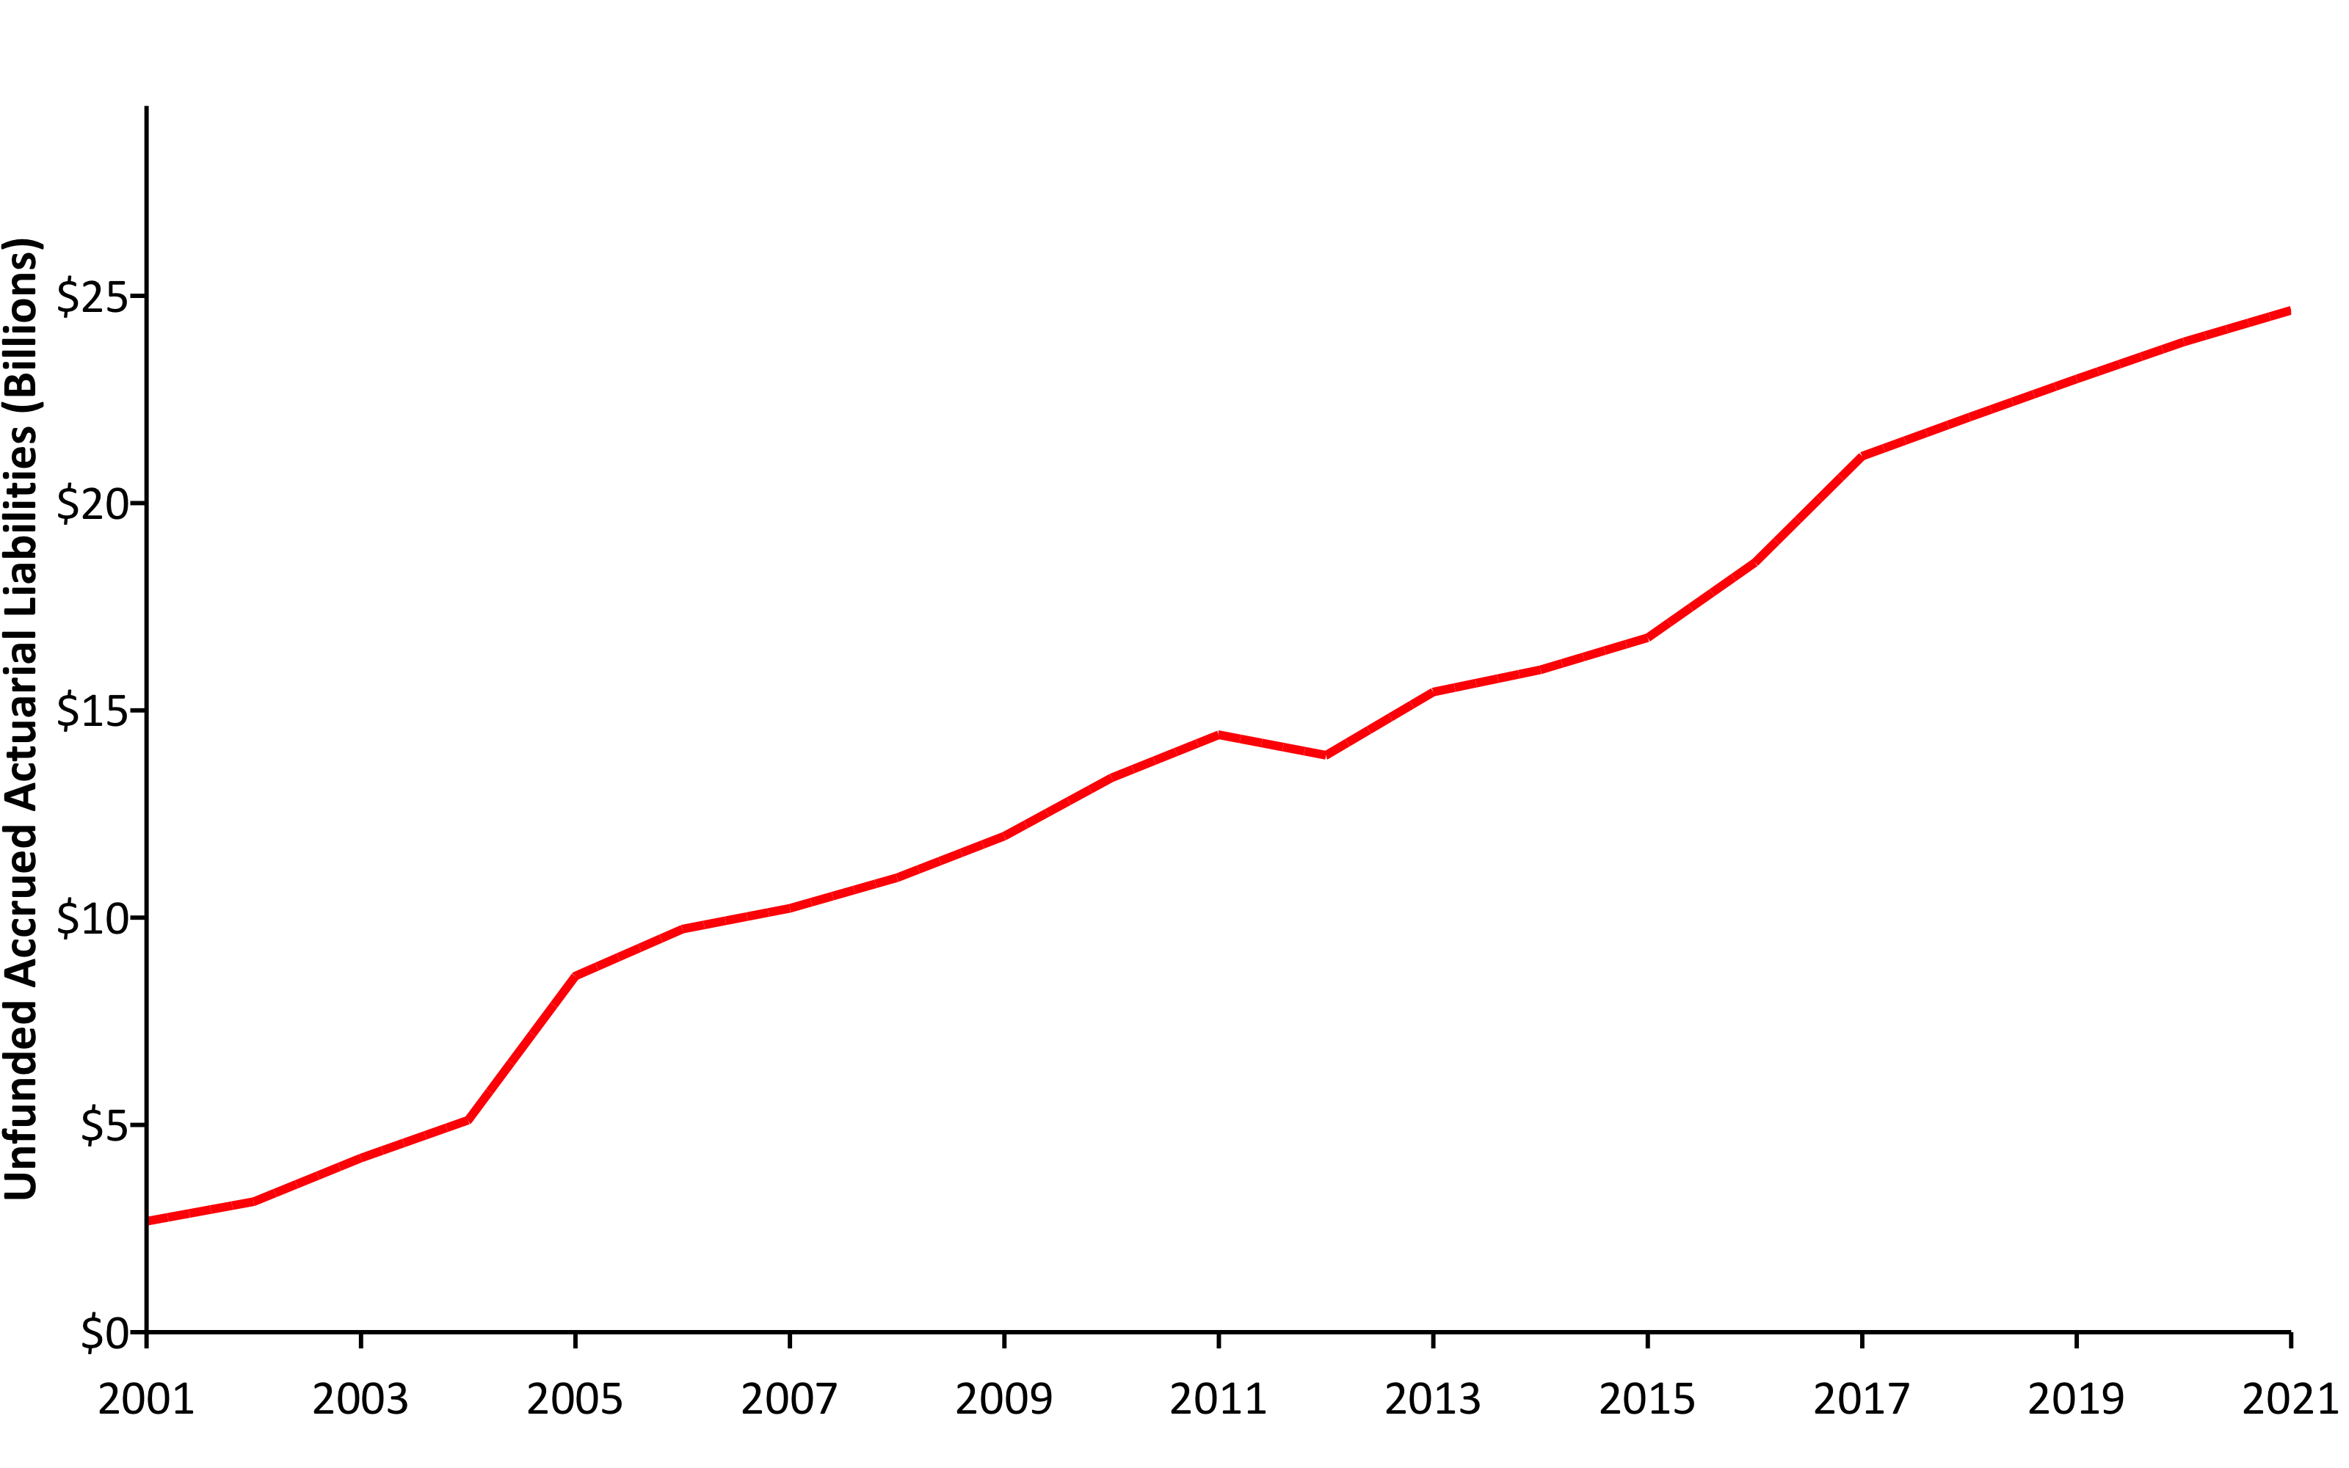
SCRS UAL #2 (2001-2021) w/ R (areaPlot())
Source: Pension Integrity Project analysis of SCRS actuarial valuation reports.

Slide 5
A History of Weakening Solvency #2 (2001/2021) w/ R (table)
 | UAL | Funded Ratio
2001 | $2,675,374,000 | 87.4%
2021 | $24,651,369,000 | 55.2%
Pension Integrity Project pension database.

Slide 6
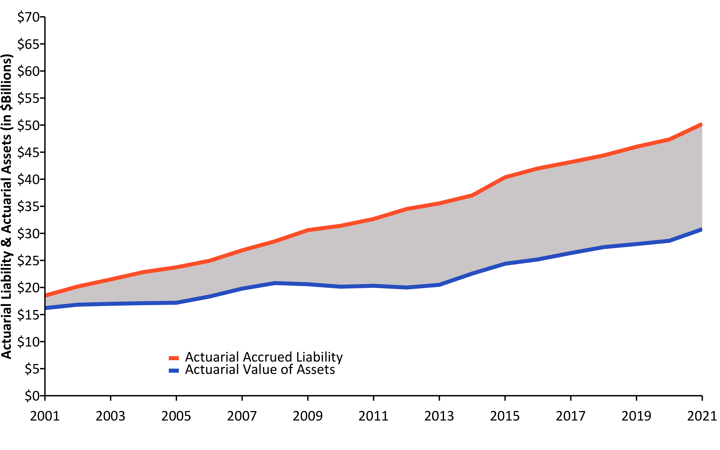
Liabilities Growing Faster than Assets (2001-2021) w/ R (linePlot())
Source: Pension Integrity Project analysis of SCRS actuarial valuation reports.

Slide 7
Causes of Pension Debt (2001-2021) w/ R (custom Plotly-Image)

Slide 8
Driving Factors Jeopardizing SCRS Resiliency
Deviations from Investment Return Assumptions have been the largest contributor to the unfunded liability growth, adding $9.82 billion from 2001 to 2021.
Changes to Actuarial Methods and Assumptions – including assumed rate of return - have revealed roughly $6.99 billion in additional unfunded liability since 2001.
Extended Amortization Timetables and low Statutory Contributions in the past have resulted in interest on SCRS debt exceeding the actual debt payments (negative amortization) since 2001, adding a net $3.68 billion to the unfunded liabilities.
Deviations from Demographic Assumptions – including deviations from assumed rates of withdrawal, retirement, and mortality — added $2.57 billion to the debt since 2001.
Ad-Hoc Cost-of-Living-Adjustments given before 2012 added $206 million to unfunded liabilities since 2001.

Slide 9
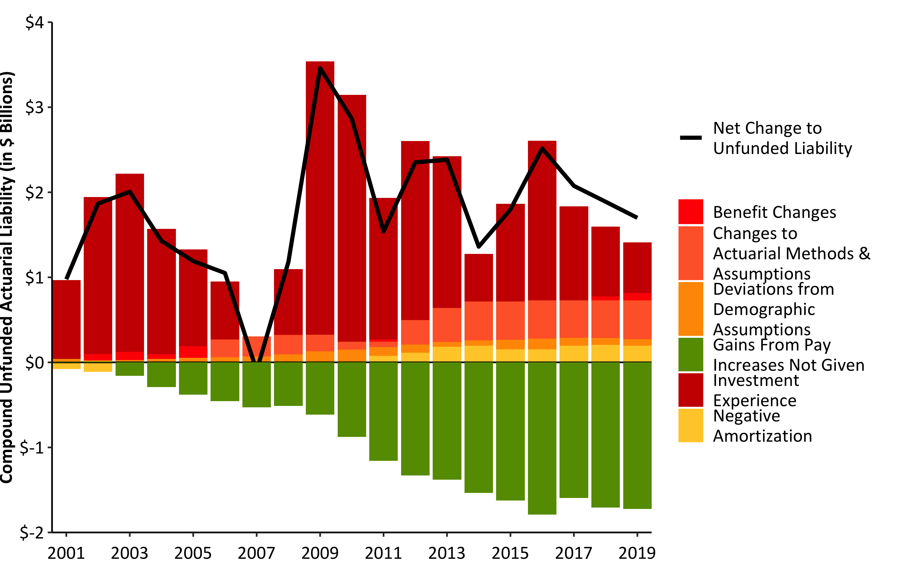
Compound Net Change to UAL w/ R (barPlot())
Source: Pension Integrity Project analysis of SCRS actuarial valuation reports.

Slide 10
Make up of Pension Contributions w/ R (flextable())
FY2023 Contributions | FY2023 Contributions | FY2023 Contributions
Contribution Type | % of Payroll | $ Value
Total Employee | 9.0% | $932,014,000
Total Employer | 17.6% | $1,742,976,450
Employer (Debt Amortization) | 15.6% | $1,549,422,687
Employer (Normal Cost) | 2.0% | $193,553,763
Total SCRS Contributions | 26.6% | $2,636,301,510

Slide 11
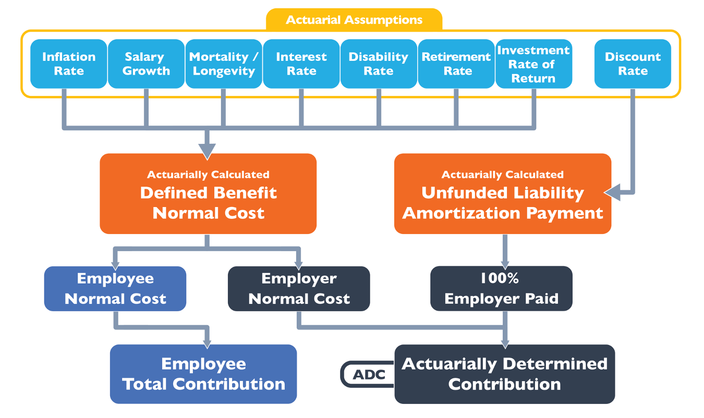
How a Pension Plan is Funded w/ Image

Slide 12
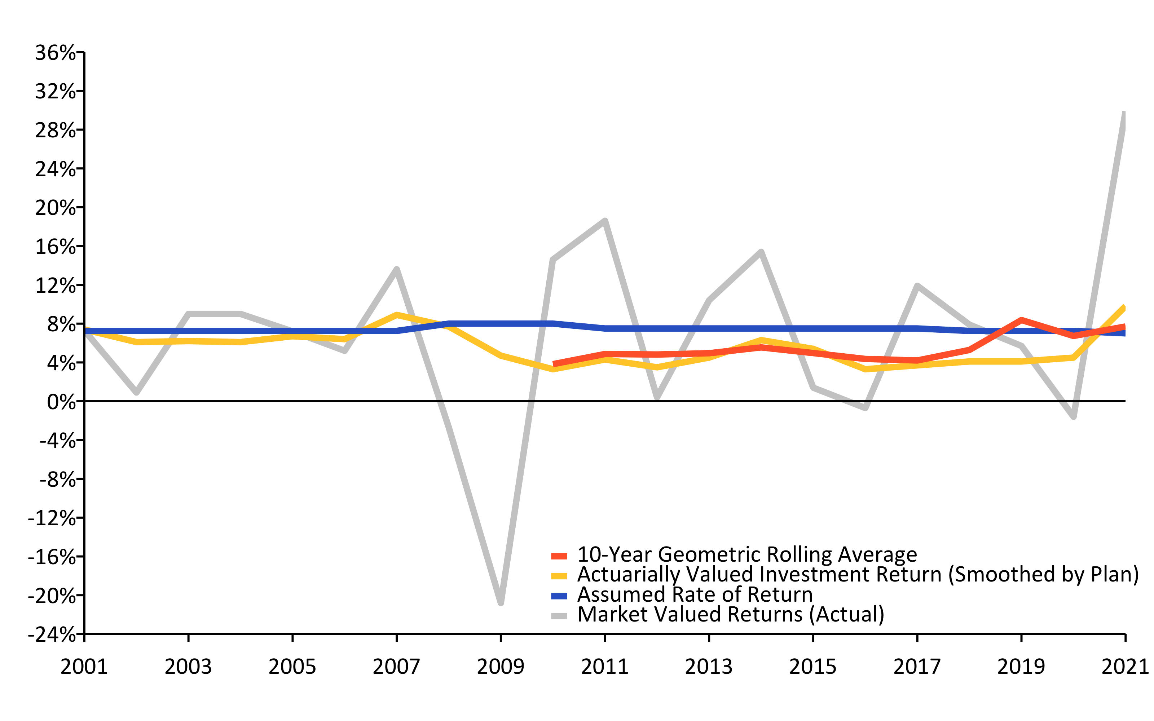
A History of Investment Returns (2001-2021) w/ R (linePlot())
Source: Pension Integrity Project analysis of SCRS actuarial valuation reports.

Slide 13
Investment Returns vs. Assumptions w/ R (flextable)
Year | Average Market Valued Returns | Average Actuarially Valued Returns
20-Years (2002-2021) | 6.3% | 5.50%
15-Years (2007-2021) | 6.3% | 5.20%
10-Years (2012-2021) | 7.7% | 4.90%
5-Years (2017-2021) | 10.3% | 5.20%

Slide 14
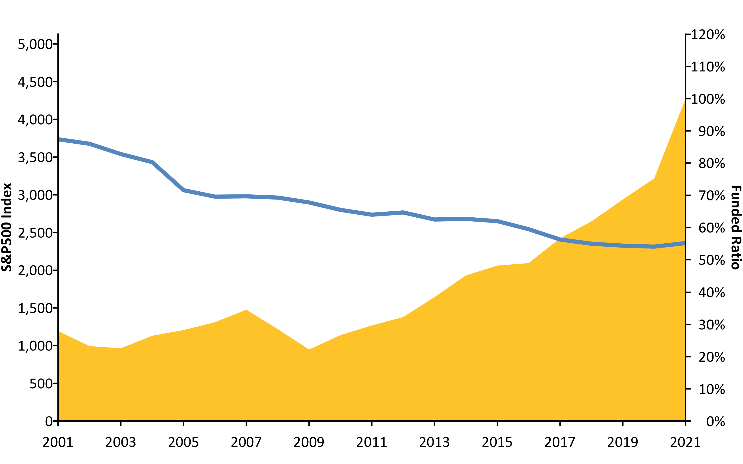
S&P500 vs. Funded Ratio (2001-2020) w/ R (areaPlot())
Source: Pension Integrity Project analysis of SCRS actuarial valuation reports.

Slide 15
New Normal: The Market Has Changed
The “new normal” for the institutional investing, despite the post-COVID rebound, suggests that achieving even a 6% average rate of return is optimistic.
Over the past two decades there has been a steady change in the nature of the institutional investment returns.
30-year Treasury yields have fallen from around 8% in the 1990s to consistently less or around 3% today.
Globally, interest rates are at the ultralow historic levels, while market liquidity continues to be restrained by financial regulations.
McKinsey & Co. forecast the returns to equities will be 20% to 50% lower over the next two decades compared to the previous three decades.
Using their forecast, the best-case scenario for a 60/40 portfolio of equities and bonds is likely to earn less than a 5% return.
As SCRS waits for the continual “rebound” its unfunded liabilities continue to grow.

Slide 16
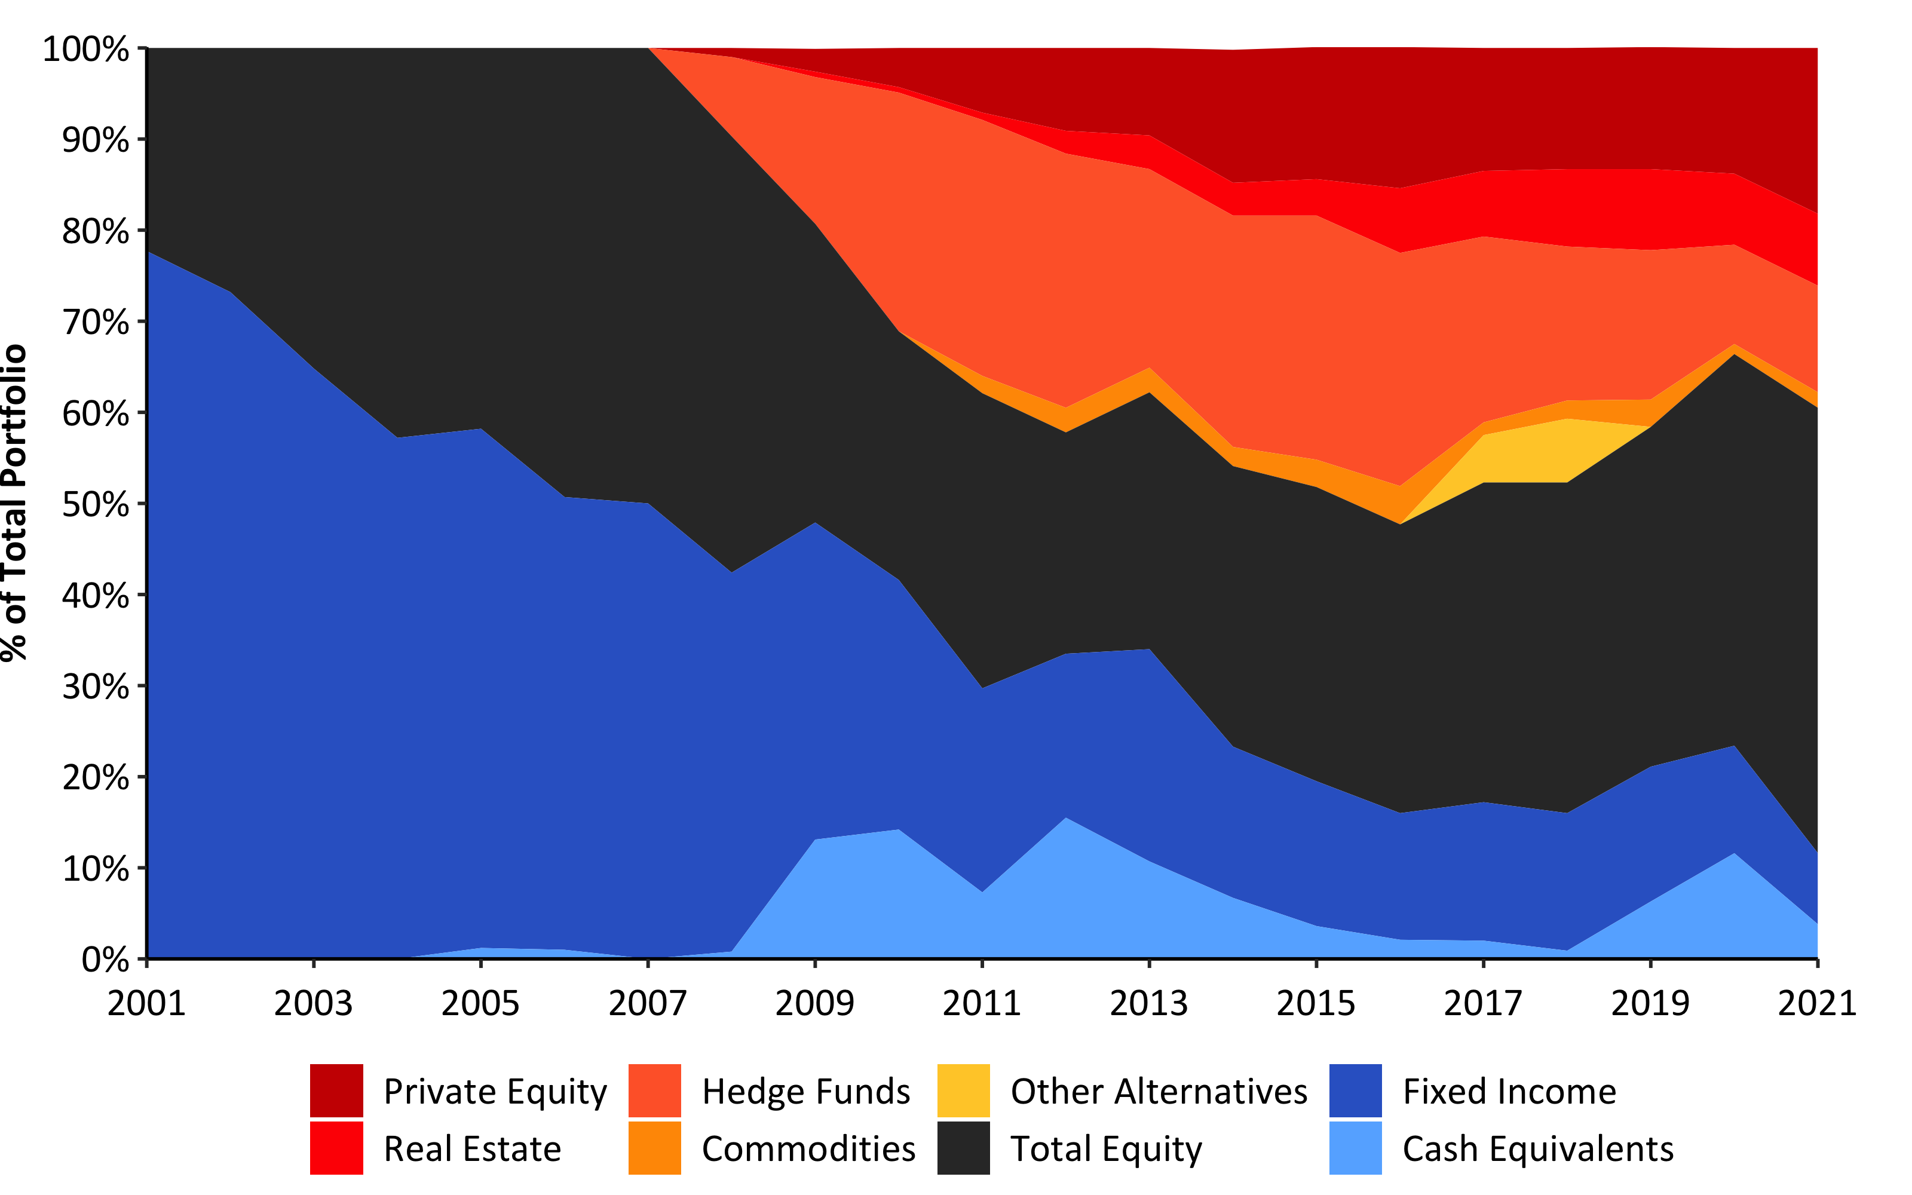
Asset Allocation (2001-2021) w/ R (custom)
Source: Pension Integrity Project analysis of SCRS actuarial valuation reports.

Slide 17
Probability Analysis w/ R (flextable())
Possible Rates of Return | Based on SCRS Assumptions | SCRS Historical Returns | Research Affiliates 10-Year Forecast | JP Morgan 10-15 Year Forecast | BNY Mellon 10-Year Forecast | Horizon 10-Year Market Forecast | Horizon 20-Year Market Forecast | BlackRock 20-Year Forecast
9 % | 23.9% | 11.8% | 4.2% | 6.2% | 10.0% | 15.6% | 24.2% | 33.0%
8 % | 36.1% | 23.0% | 9.5% | 13.3% | 19.8% | 25.7% | 36.5% | 46.5%
7 % | 50.1% | 38.3% | 18.2% | 24.6% | 33.8% | 38.2% | 50.5% | 60.6%
6.5 % | 57.3% | 47.0% | 24.0% | 31.8% | 41.9% | 45.2% | 57.6% | 67.2%
6 % | 64.1% | 56.0% | 30.7% | 39.6% | 50.5% | 52.3% | 64.4% | 73.4%
5.5 % | 70.6% | 64.5% | 38.0% | 47.9% | 59.1% | 59.4% | 70.9% | 78.9%
5 % | 76.4% | 72.4% | 45.9% | 56.4% | 67.3% | 66.1% | 76.6% | 83.7%

Slide 18
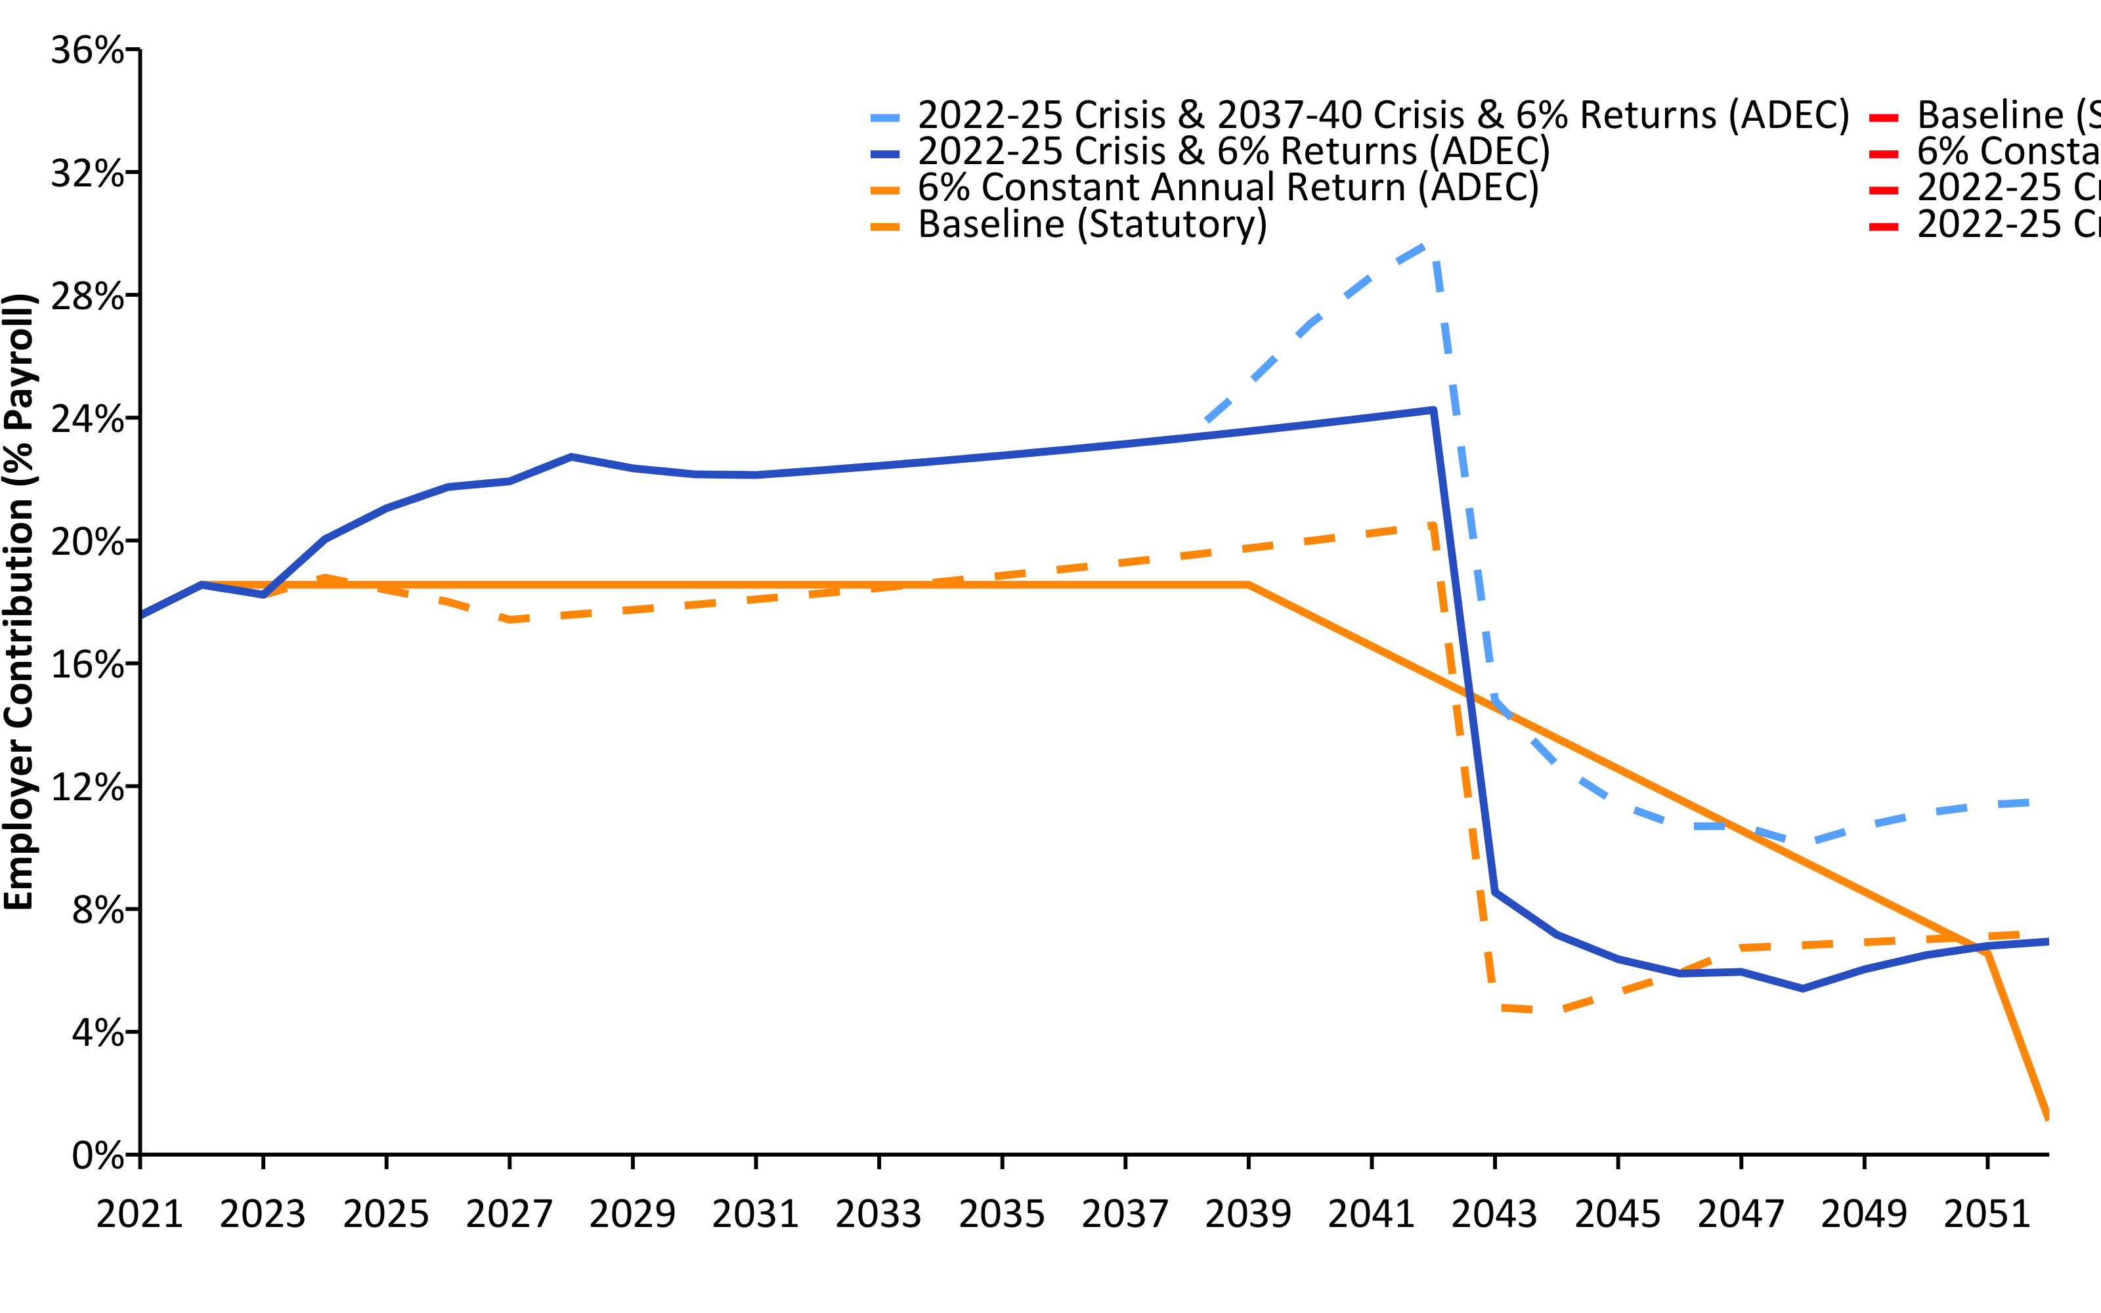
Current Contributions Are Actuarially Insufficient (2021-2052) w/ R (linePlot())
Source: Pension Integrity Project actuarial forecast of SCRS.

Slide 19
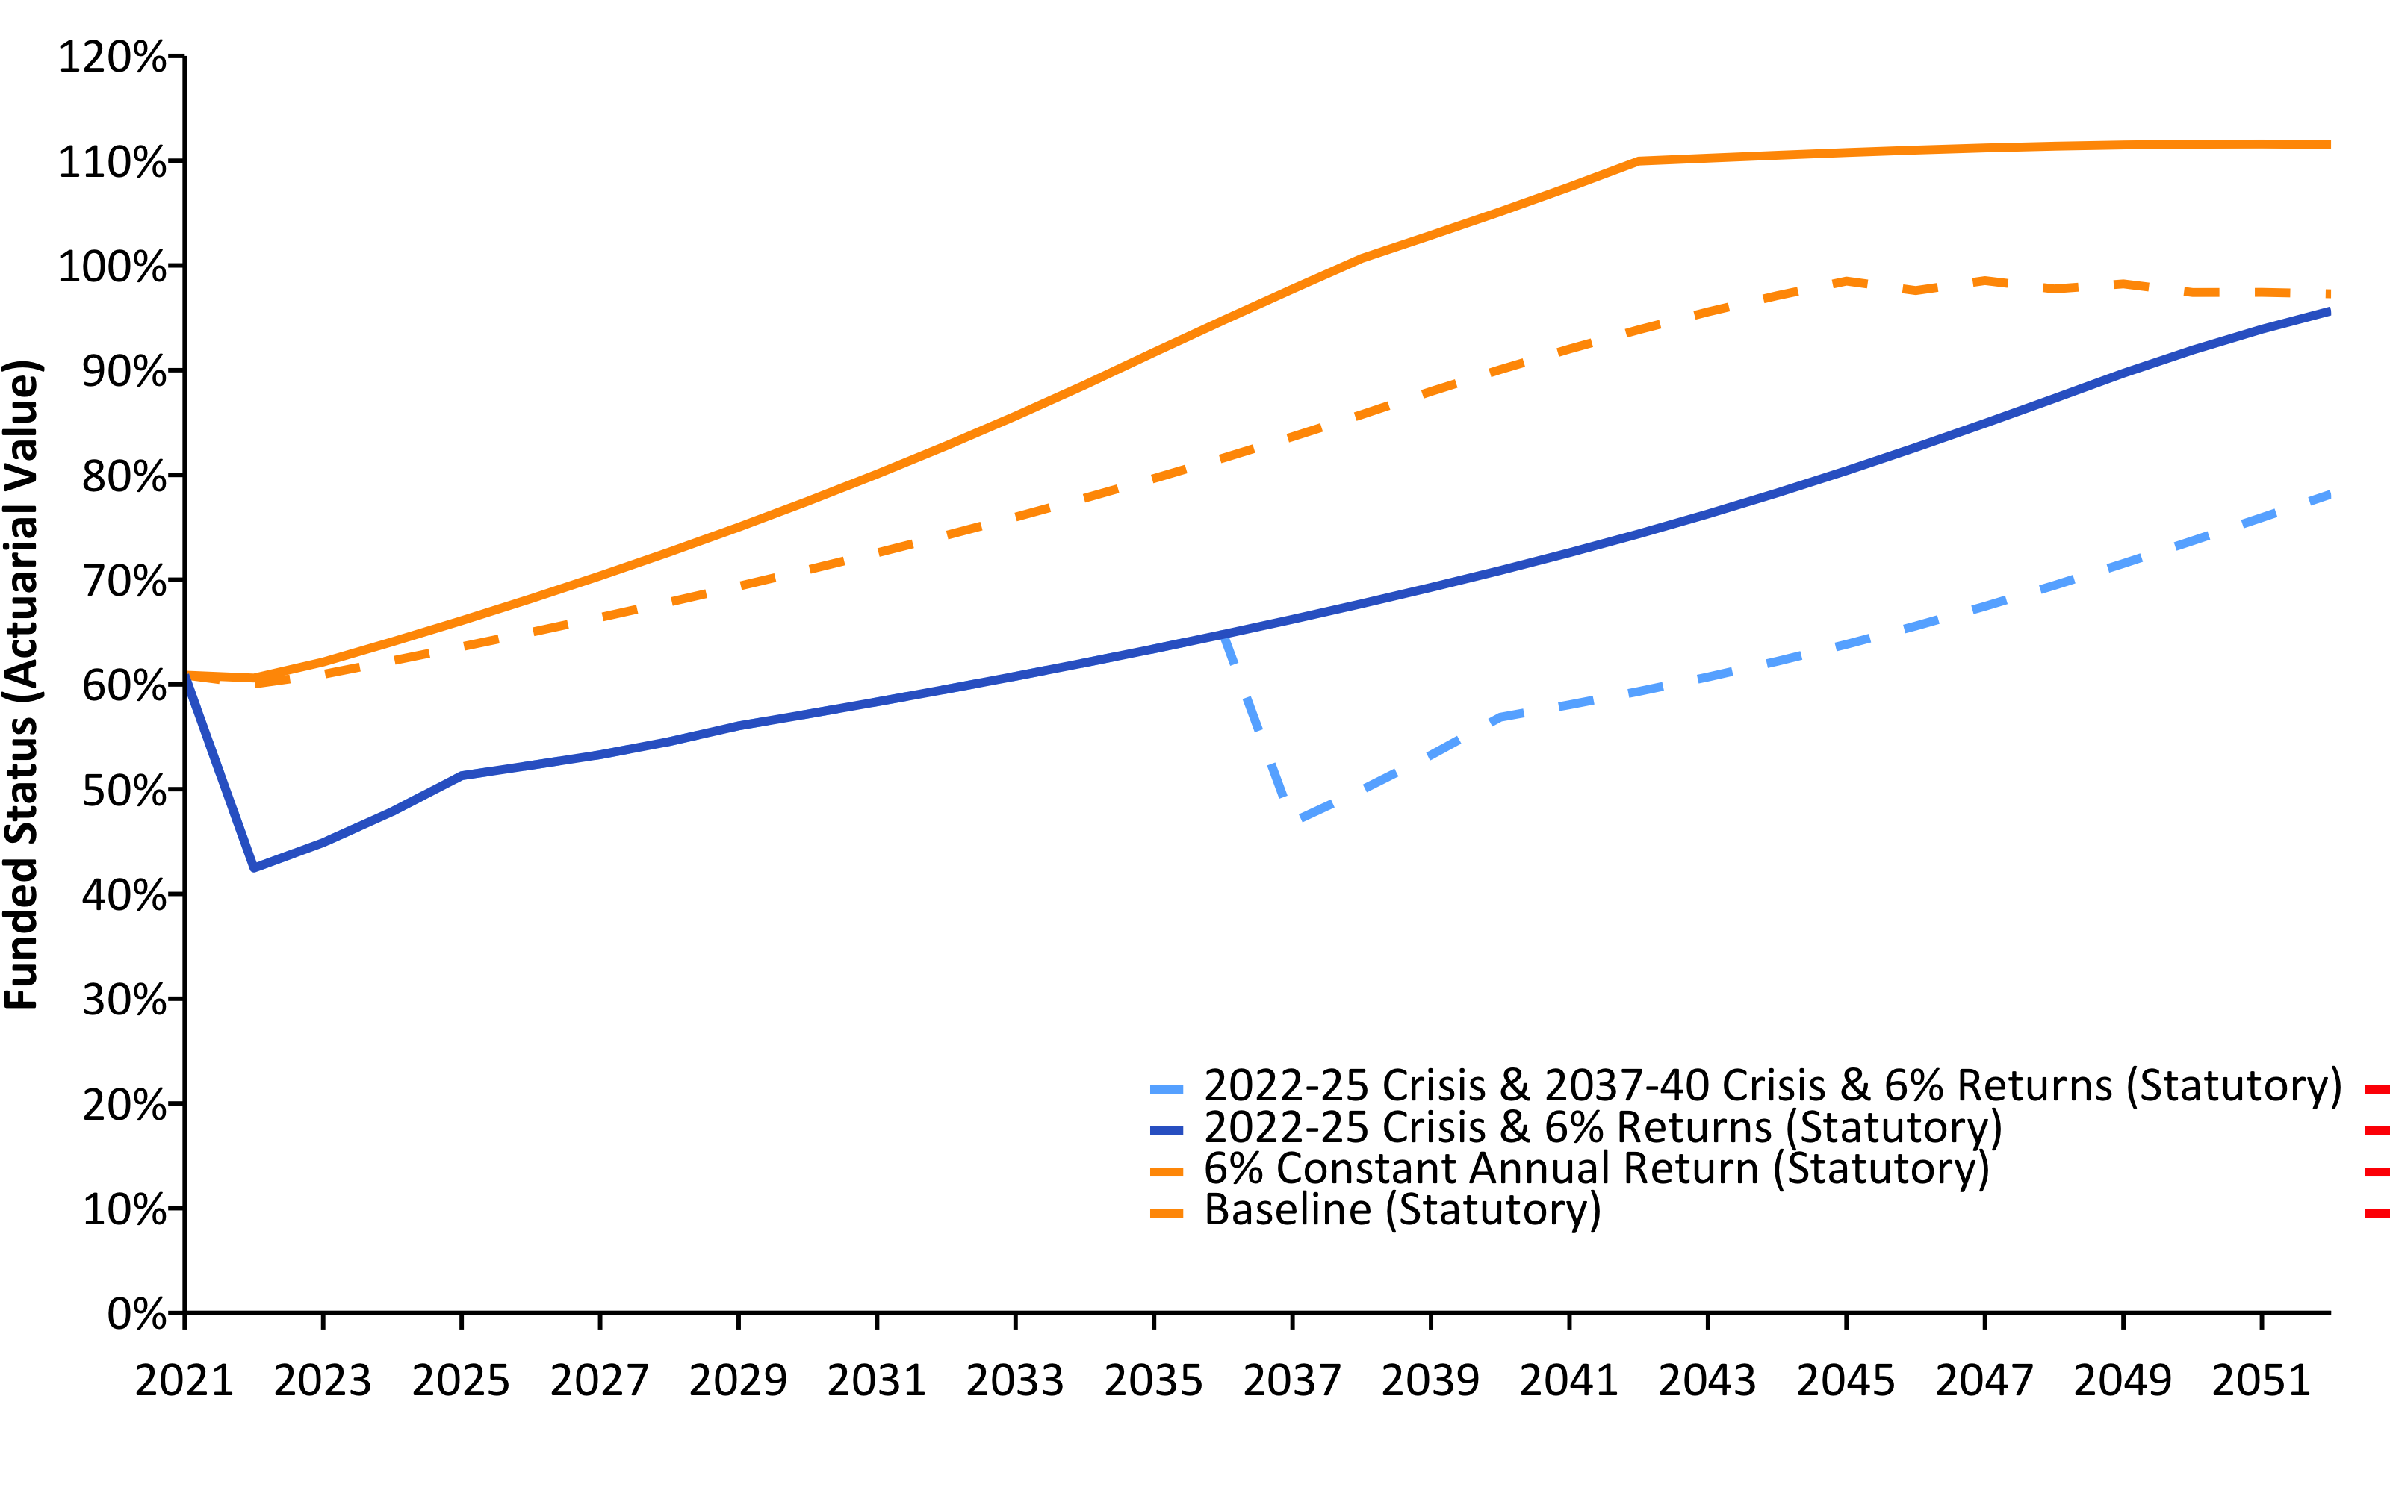
SCRS Solvency Degrades Under Crisis Scenarios (2021-2052) w/ R (linePlot())
Source: Pension Integrity Project actuarial forecast of SCRS.

Slide 20
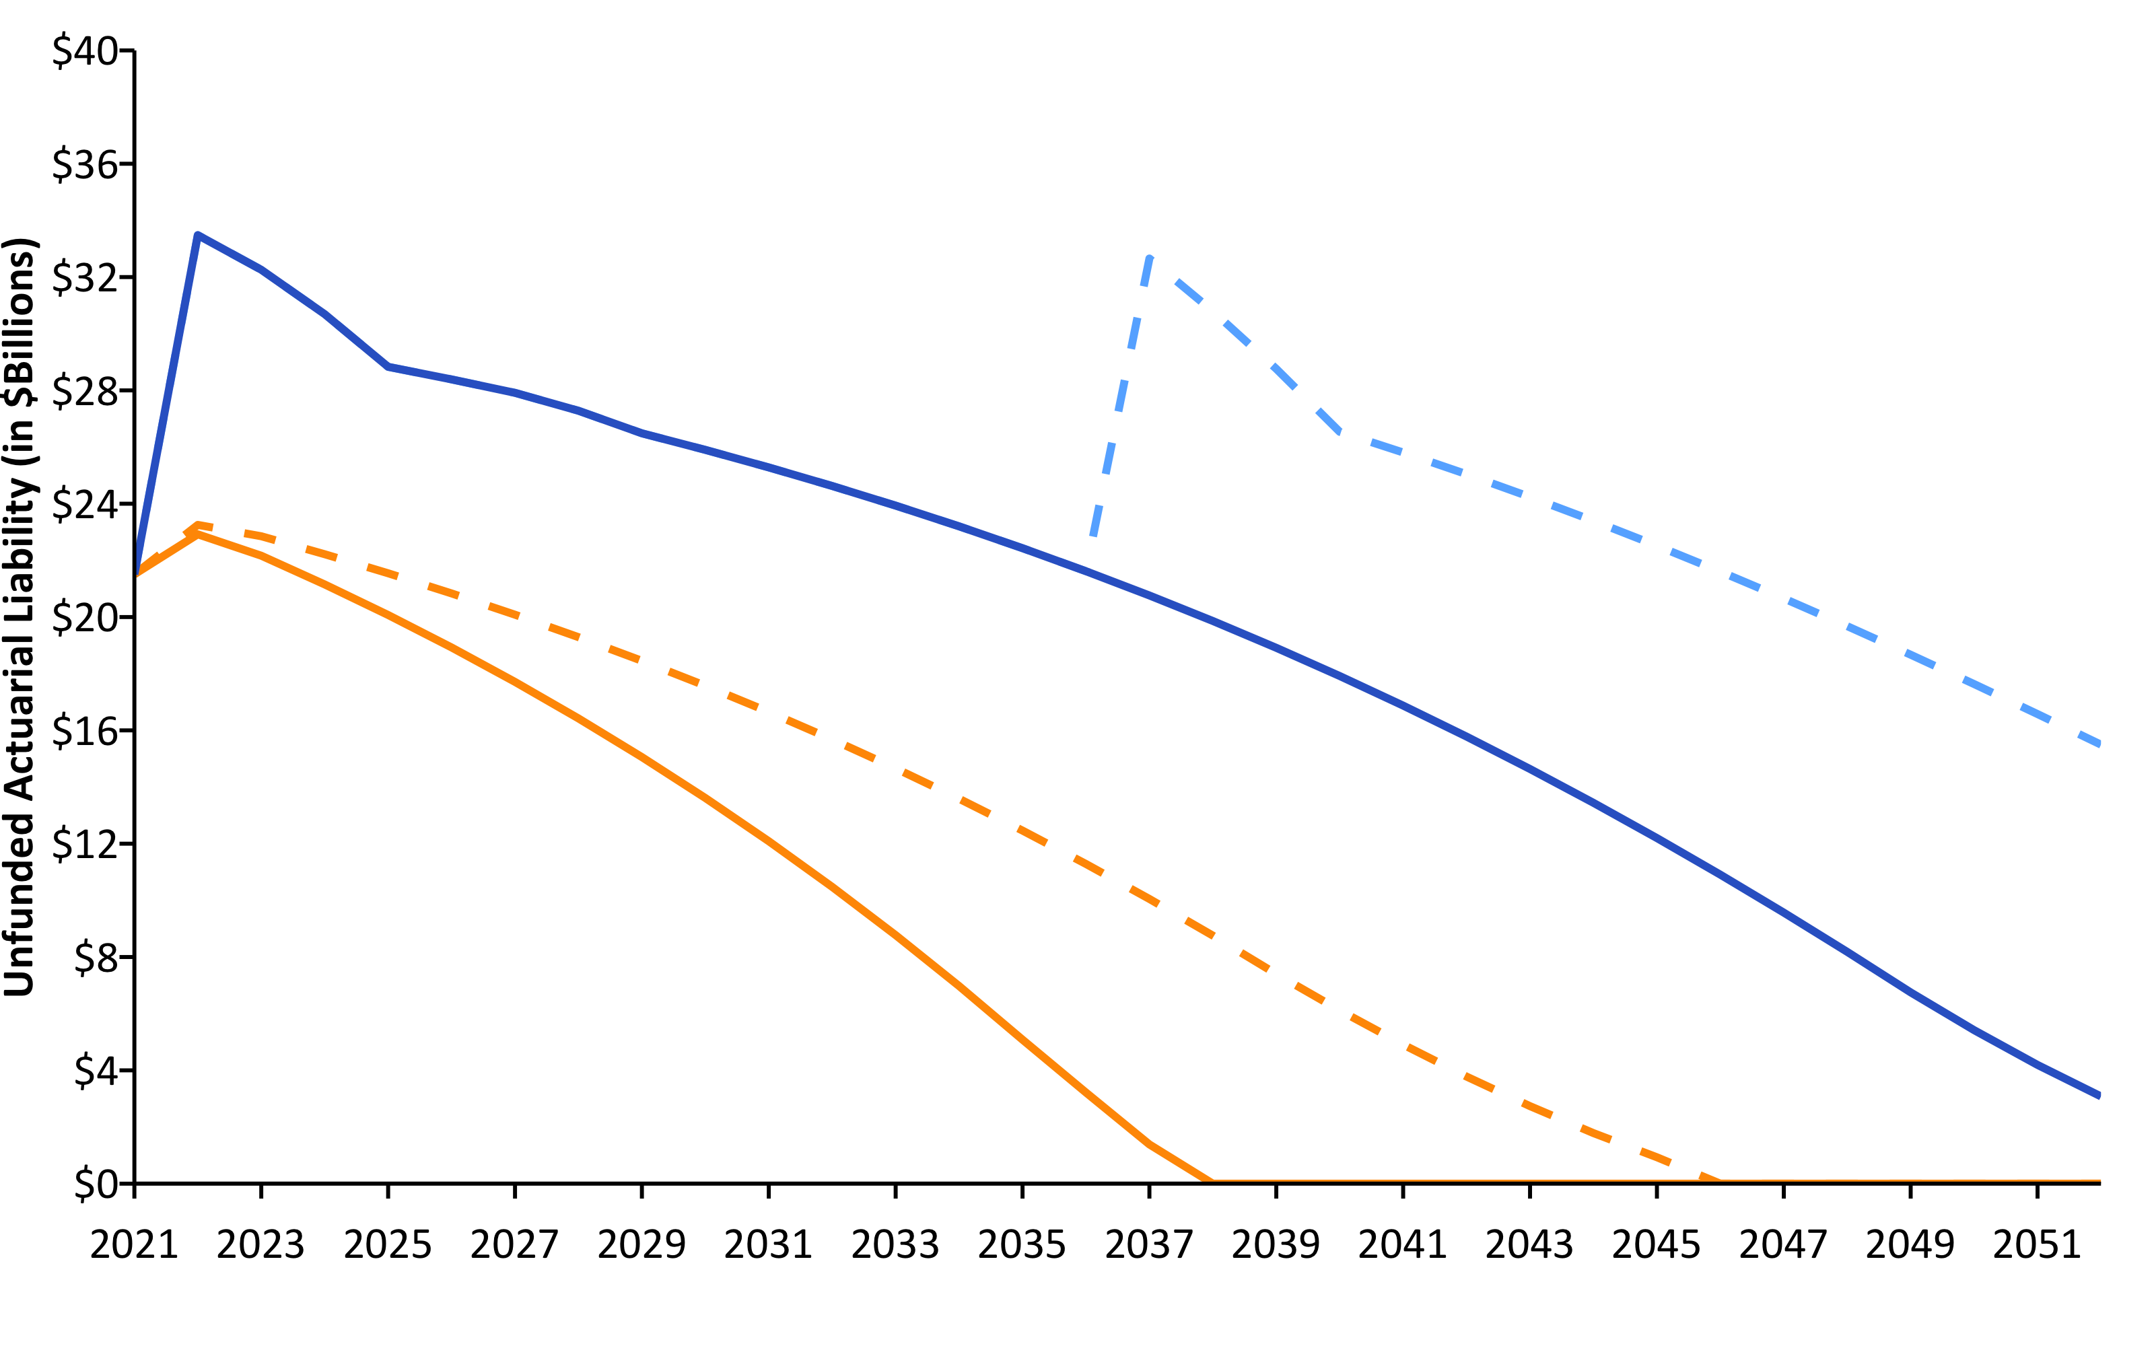
Pension Debt Will Likely Grow (2021-2052) w/ R (linePlot())
Source: Pension Integrity Project actuarial forecast of SCRS.

Slide 21
SCRS Unfunded Liability Sensitivity to DR Changes 2021 w/ R (flextable())
Discount Rate | Funded Ratio (MVA) | Unfunded Liability (MVA) | Actuarial Accrued Liability
7.0% | 60.9% | $21.50 | $55.00
6.0% | 54.3% | $28.20 | $61.70
5.0% | 48.0% | $36.30 | $69.80
4.0% | 42.1% | $46.10 | $79.50

Slide 22
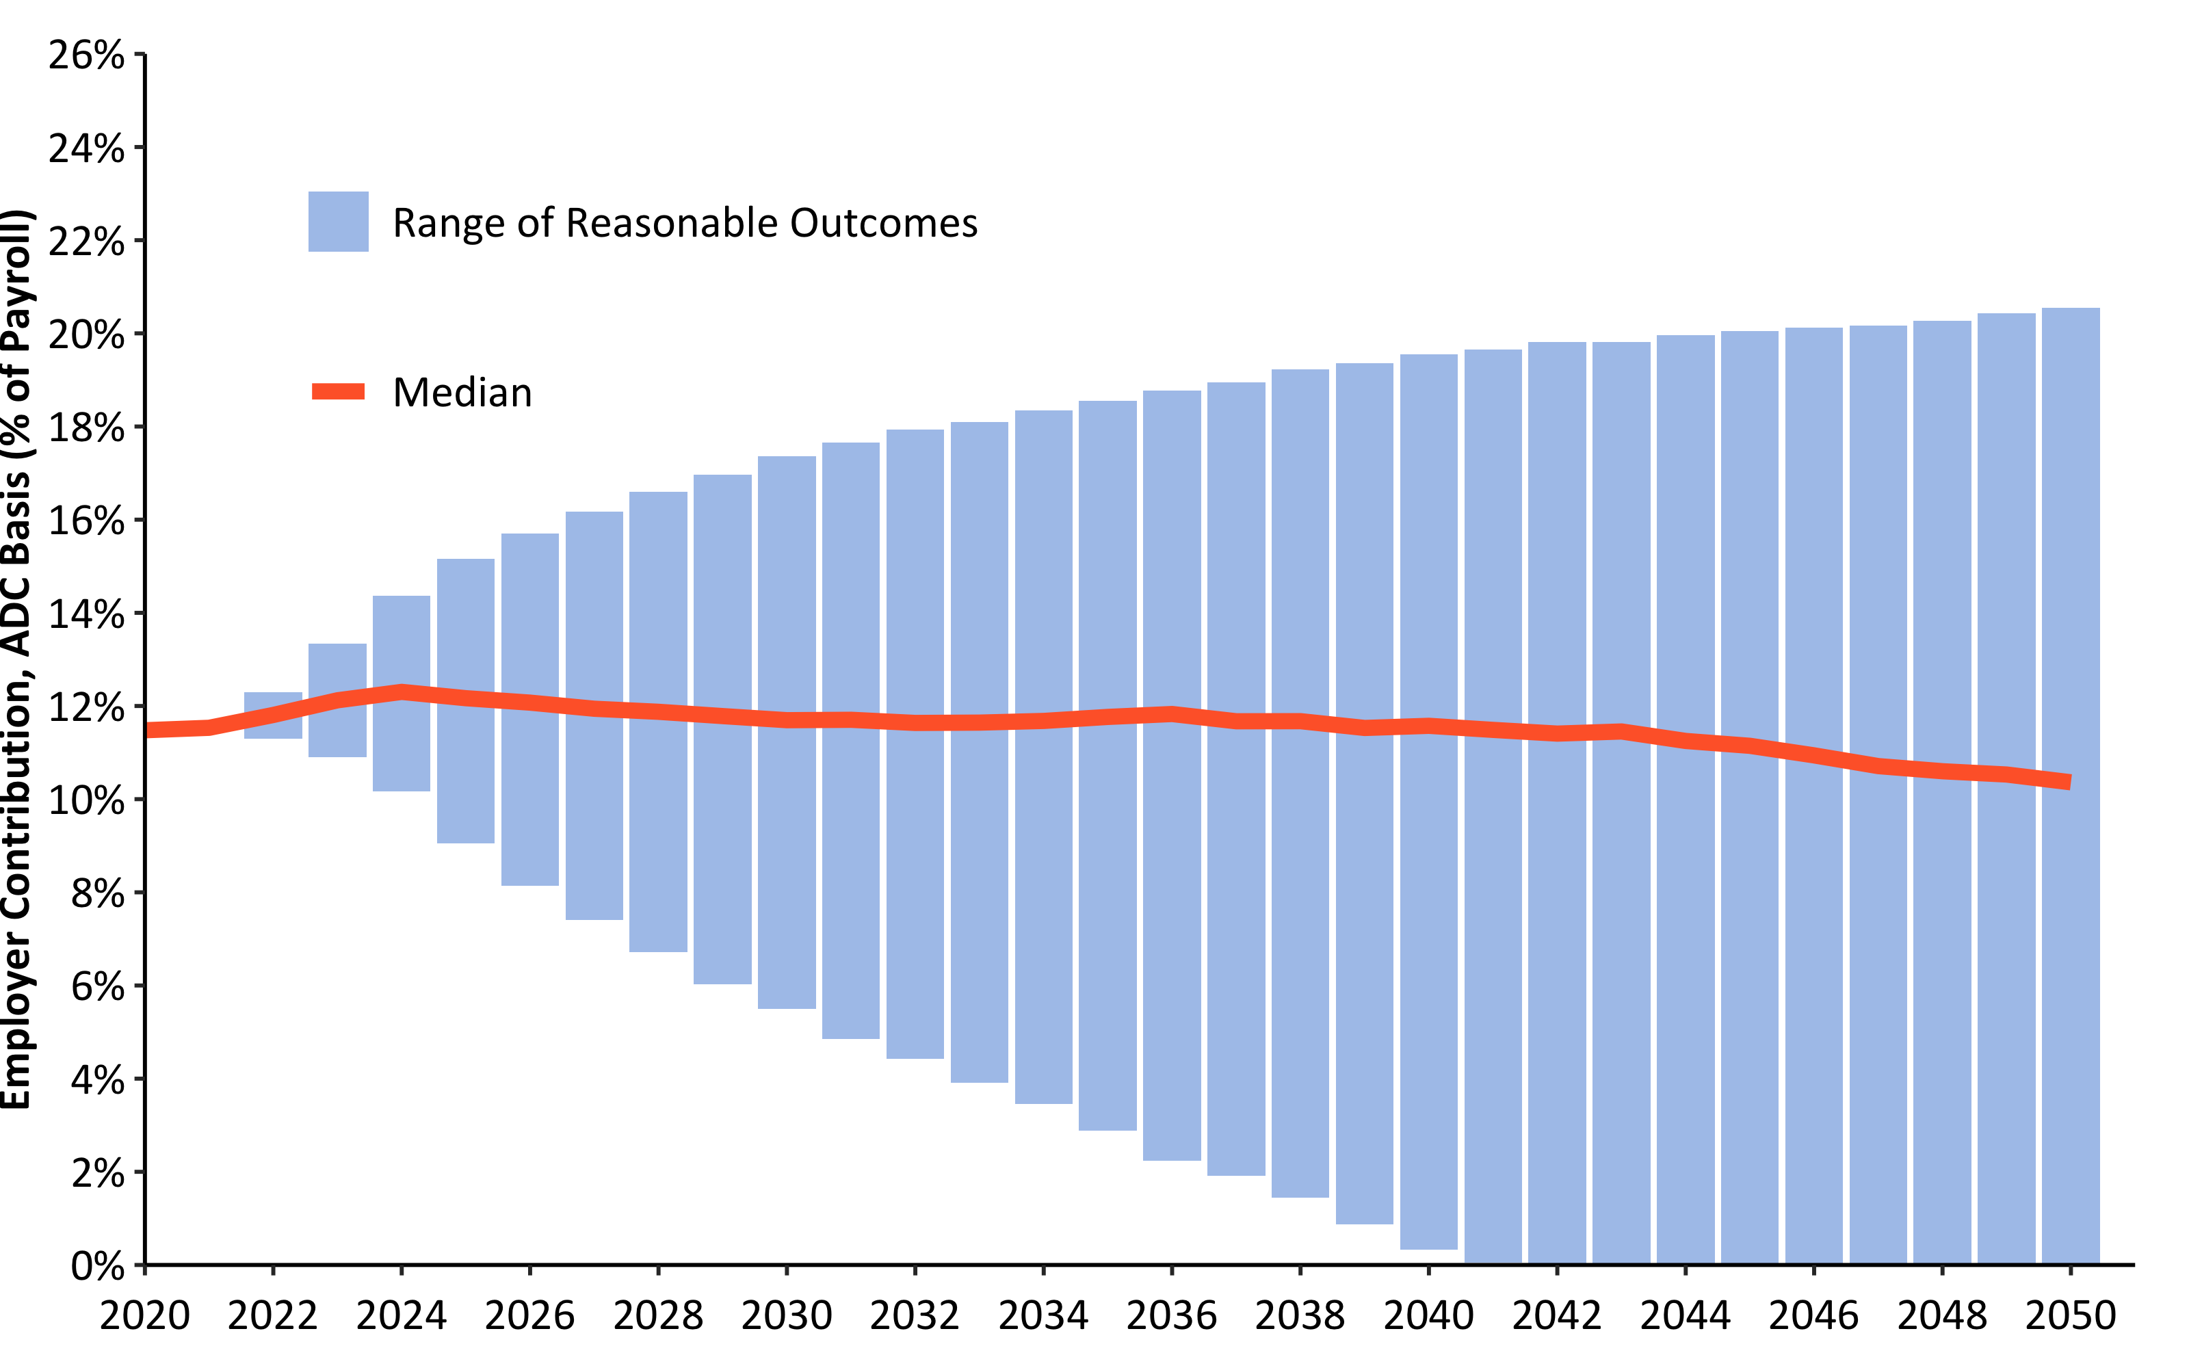
30-Year Employer Contribution Forecast w/ R (barPlot())
Source: Pension Integrity Project actuarial forecast of SCRS.

Slide 23
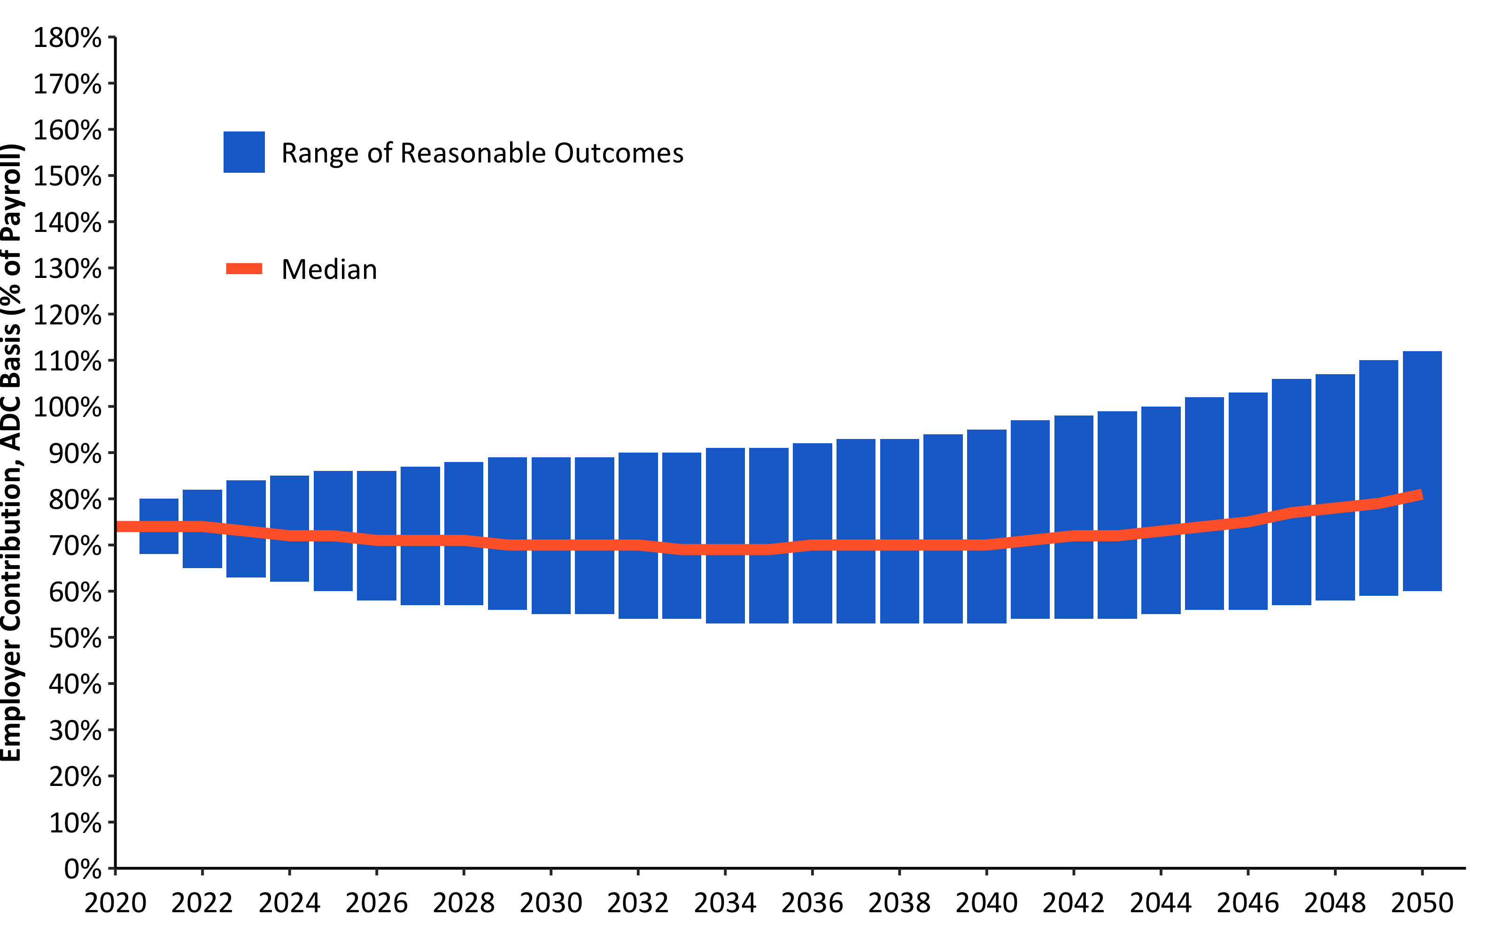
30-Year Funded Ratio Forecast w/ R (barPlot())
Source: Pension Integrity Project actuarial forecast of SCRS.

Slide 24
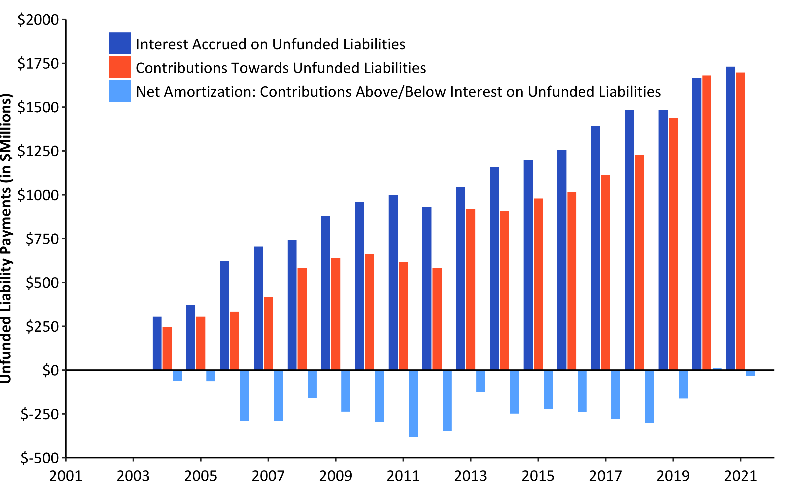
Debt Interest vs. Unfunded Liability Payments (2001-2021) w/ R (w/ barPlot())
Source: Pension Integrity Project analysis of SCRS actuarial valuation reports.

Slide 25
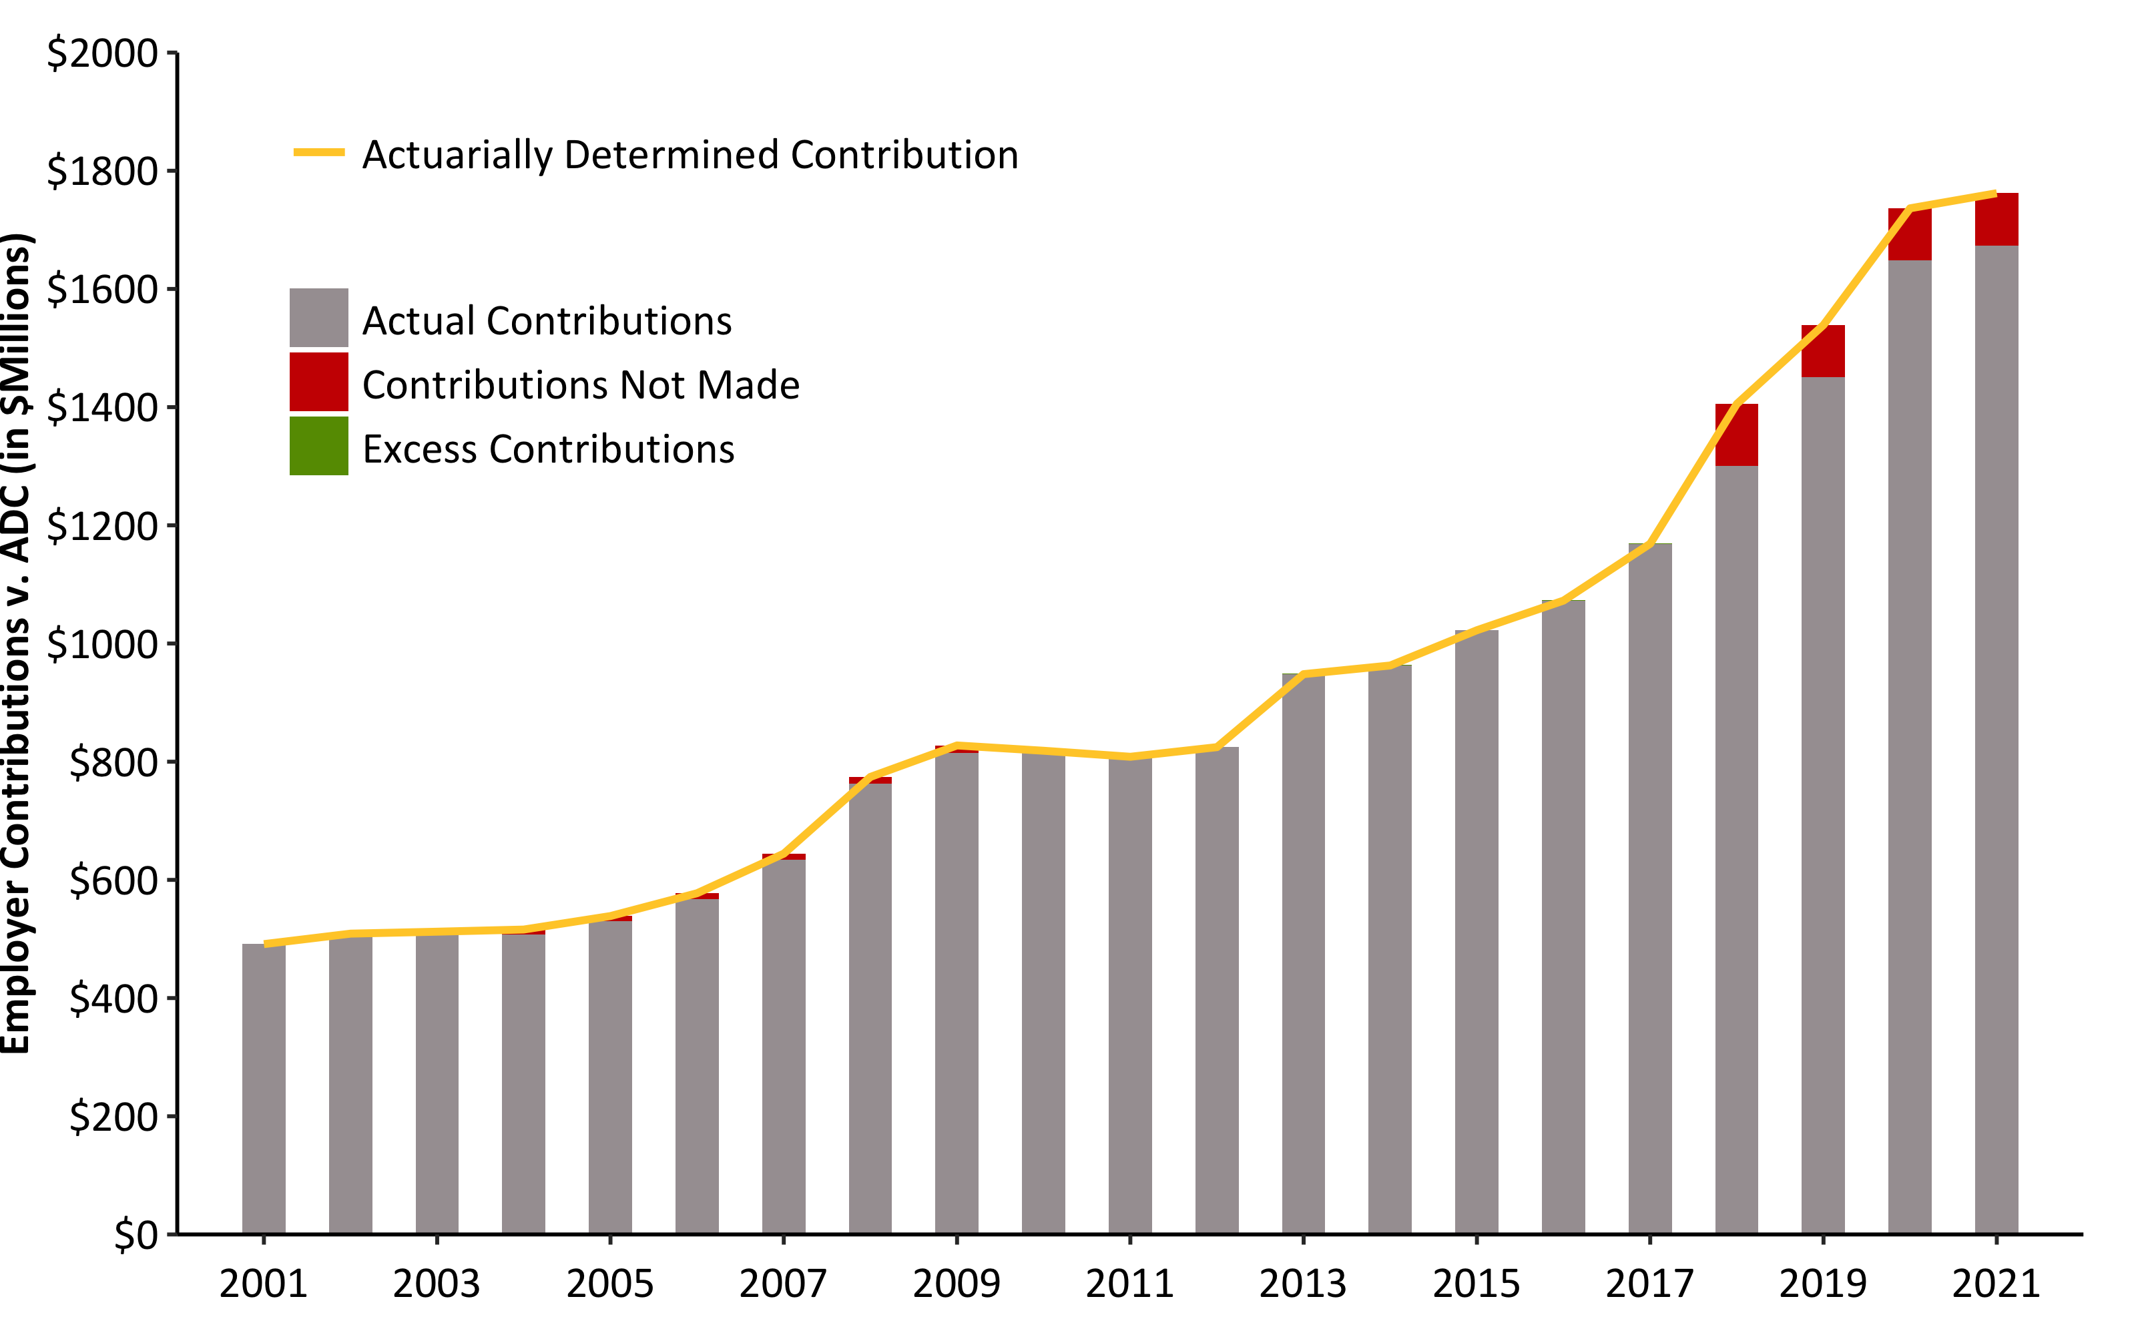
ADEC Contribution History (2001-2021) w/ R (barPlot())
Source: Pension Integrity Project analysis of SCRS actuarial valuation reports.

Slide 26
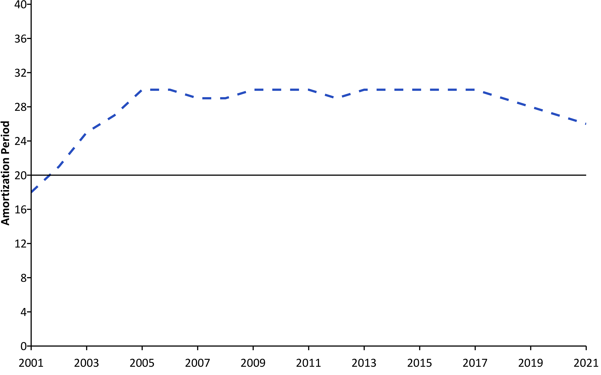
SCRS Amortization Period (2001-2021) custom R
Source: Pension Integrity Project analysis of SCRS actuarial valuation reports.

Slide 27
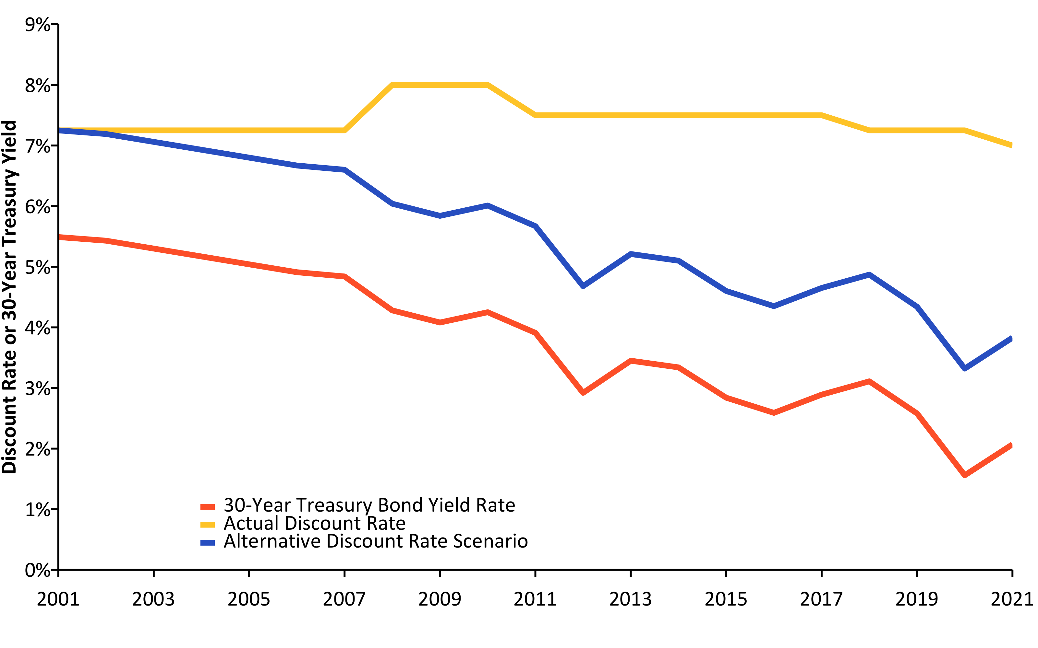
Change in Risk-Free Rate vs. Discount Rate (2001-2021) w/ R (linePlot())
Source: Pension Integrity Project analysis of SCRS actuarial valuation reports.

Slide 28
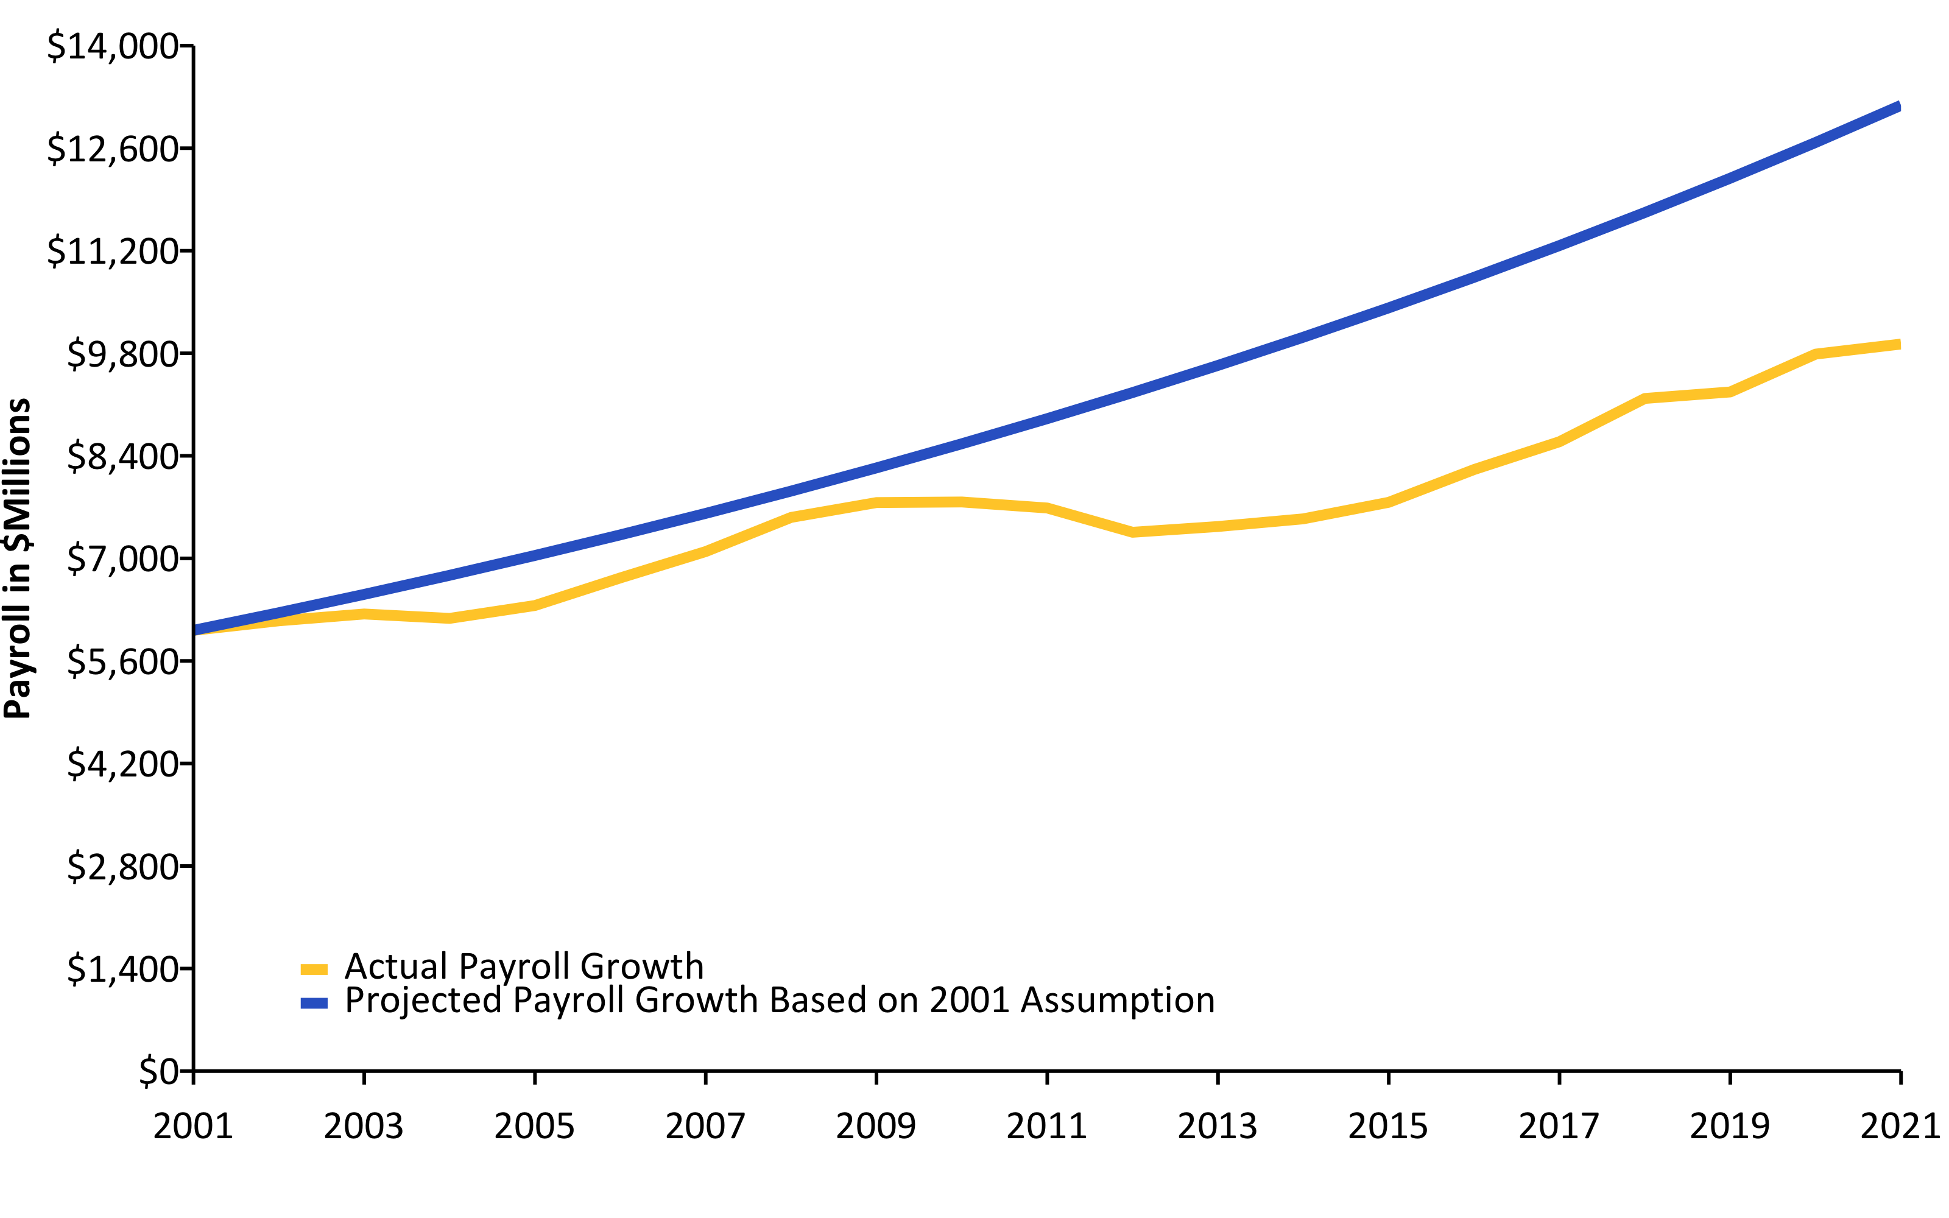
Actual Change in Payroll vs. Assumption (2001-2021) w/ R (linePlot())
Source: Pension Integrity Project analysis of SCRS actuarial valuation reports. Actual payroll does not include payroll for members in ORP or working retirees.

Slide 29
Actual Inflation vs. Assumption (2001-2020) w/ R (linePlot())
## Response [https://raw.githubusercontent.com/ReasonFoundation/databaseR/master/files/CPI_by_Region_DOL.xlsx] ## Date: 2022-02-06 15:28 ## Status: 200 ## Content-Type: application/octet-stream ## Size: 13.8 kB ## <ON DISK> /var/folders/0z/p5zgjmbn6531bgclzwc383500000gn/T//Rtmp5FgXvW/file10b64274f8a0.xlsx

Slide 30
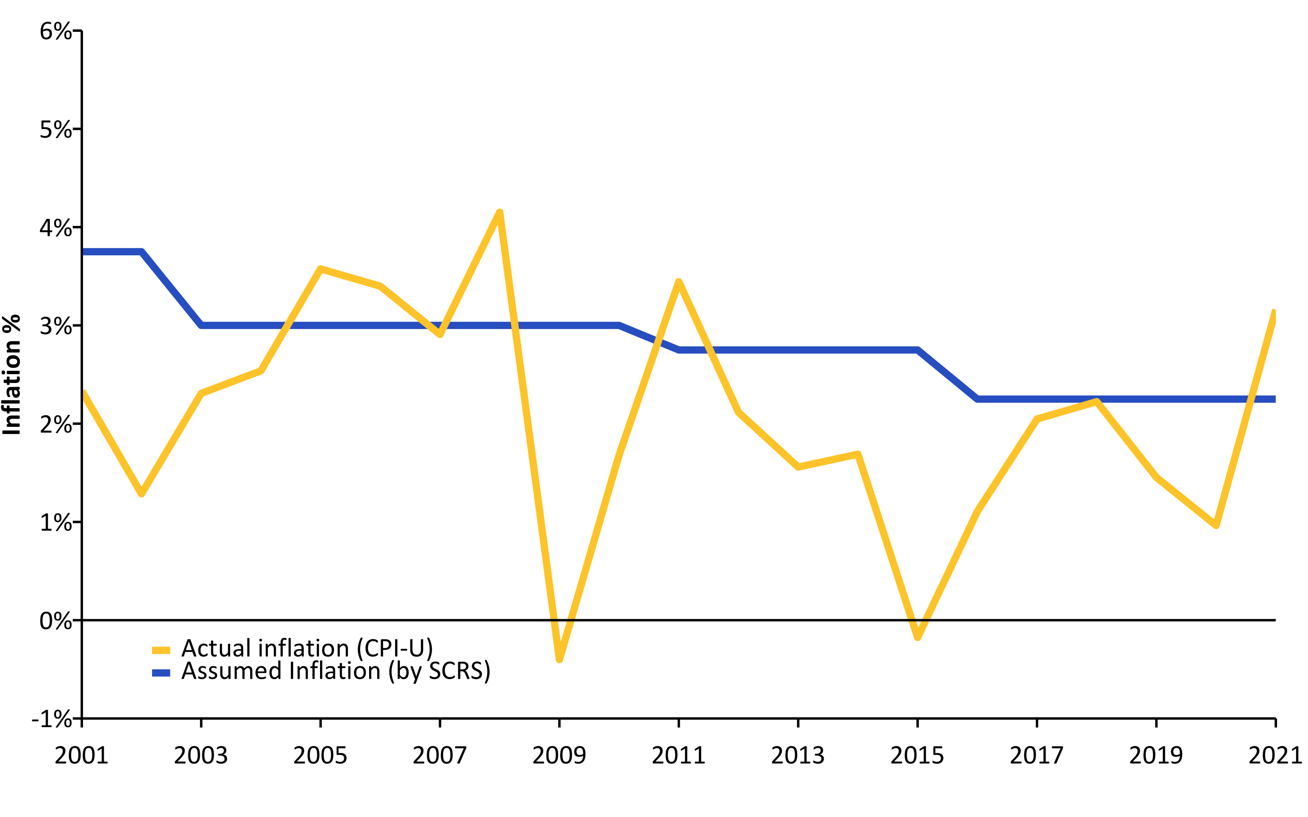
Source: Pension Integrity Project analysis of SCRS actuarial valuation reports.

Slide 31
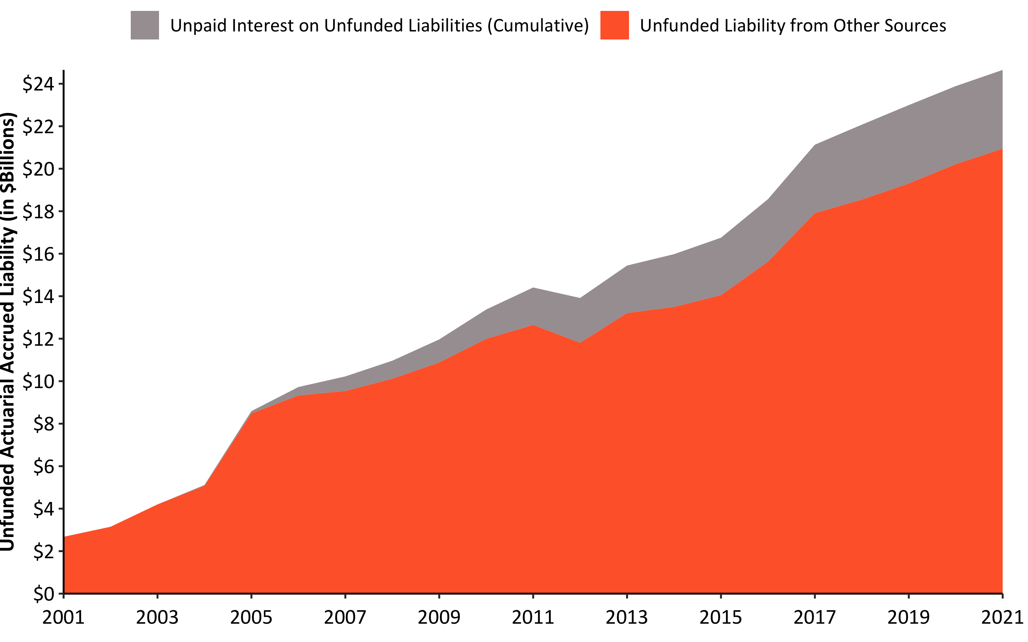
Interest on Debt 2001-2021 w/ R (custom)
Source: Pension Integrity Project analysis of SCRS actuarial valuation reports.

Slide 32
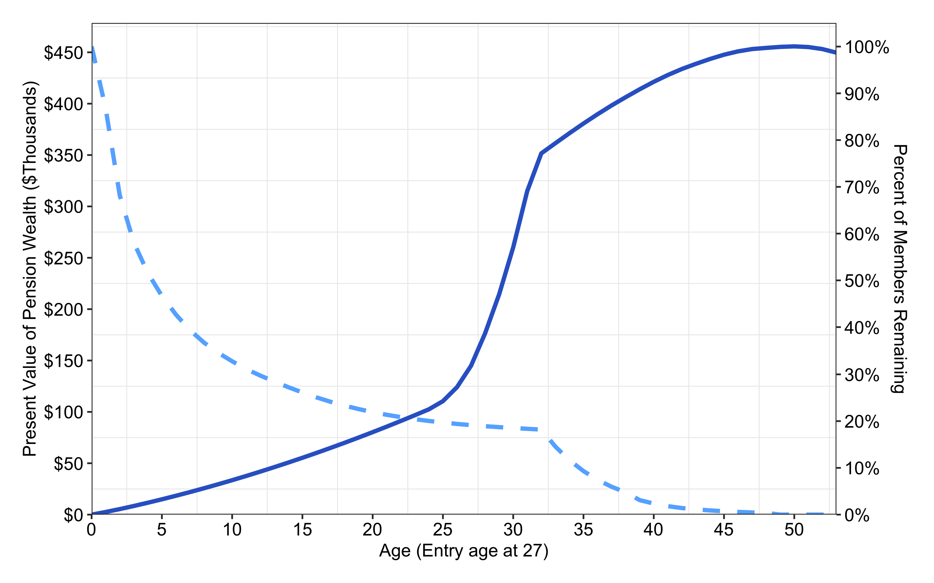
Benefit Accrual & Retention for an Average New SCRS Employee (Age 27) w/ R (custom)
Source: Pension Integrity Project analysis of SCRS actuarial reports and CAFRs. Illustration is based on plan’s Class Three assumptions and a hypothetical analysis of an average new member hired at the age of 27

Slide 33
Delaying Eligibility for Full Benefits Backloads 27 Age New SCRS Hires’ Benefits
Only $176.48K is what new Age 27 (Class Three) SCRS members will accrue after 28 years on the job (accrued benefits valued at retirement).
All new employees are better off collecting their own contributions (with credited interest), before they qualify for Reduced or Full Defined Benefits.
Value of accrued benefits jumps to $351.64K (or by 99.3%) just after 4 more years (Age 59, long enough to receive Unreduced/Full benefits)
Such spikes are caused by employer awarding a significantly higher total benefits in the employee’s later years of service.
This backloading usually benefits only small portion of long-career employees, leaving most of younger workers behind.

Slide 34
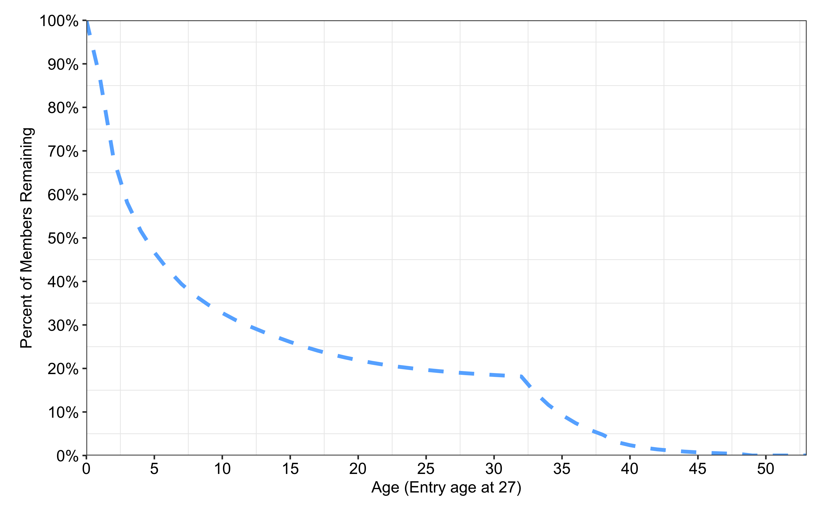
Retention Rates for a New SCRS Employee w/ R (custom)
Source: Pension Integrity Project analysis of SCRS actuarial reports and CAFRs. Illustration is based on plan’s Class Three assumptions and a hypothetical analysis of an average new member hired at the age of 27

Slide 35
Retention: Only Few of 27 Age New SCRS Hires Receive Benefits
Only 36.7% of new Age 27 (Class Three) SCRS members will stay for 8 years.
Class Three employees must work 8 years before their benefits become vested.
Members who leave the plan before then must forfeit contributions their employer made on their behalf.
Only 21.9% of the initial employees will accrue 20 years of service.
And only 18.2% of Age 27 Class Three members hired next year will still be working after reaching Rule of 90 threshold (Age + Years of Service), long enough to qualify for unreduced benefits.

Slide 36
References
https://github.com/ReasonFoundation/GraphicsR
https://rstudio.com/wp-content/uploads/2015/03/rmarkdown-reference.pdf
https://bookdown.org/yihui/rmarkdown/

